Slide 1




FINAL PROJECT REPORT
Fundamentals of Programming
Presented by :
Group 6
Prerna Kapani – 8984047
Sneha Patel – 8962629
Falgun Parikh – 8994929
Kina – 8850437
Nitigya Vasudev - 8977453

Slide 2

About the Dataset
Patient attributes affect health risk.
Age, gender, lifestyle crucial.
Environmental exposures impact health outcomes.
Air pollution, dust allergies significant.
Respiratory issues need primary factors.
Chronic lung disease prevalent.
Effective prevention, management strategies essential.
1

Slide 3
Technicalities
Scikit-learn
train_test_split()
LabelEncoder()
RandomForestClassifier()
LogisticRegression()
SVC() (Support Vector machine)
GaussianNB()
accuracy_score()
precision_score()
recall_score()
f1_score()
confusion_matrix()
Basic Python functions
loc[]
equals()
concat()
drop()
reset_index()
isnull()
dtypes()
describe()
lambda
map()
Pandas
read_excel()
concat()
2

Slide 4
Continuation...
Models Created
Random Forest Classifier
Logistic regression
Support Vector Machine (SVN)
Gaussian Naive Bayes
Data Visualization (using seaborn and matplotlib)
Pie Chart
Bar Chart
Box plot
Scatter plot
3

Slide 5
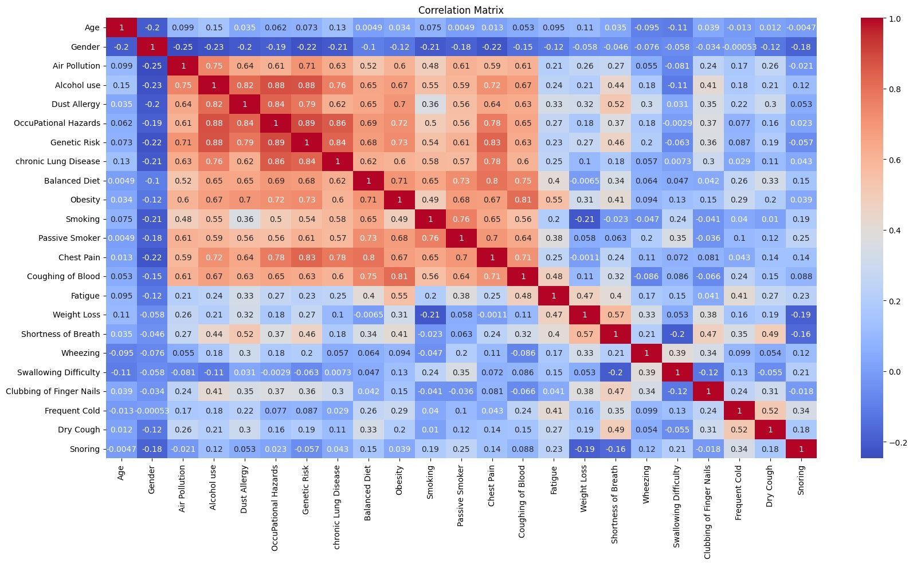
Correlation Matrix
4

Slide 6
Analysis of Variables Dropped
Low correlation with target variable.
Weak linear relationship with outcome.
Multicollinearity concerns, high correlation.
Avoid distortion, weaken statistical power.
Simplicity and parsimony for interpretability.
Efficiency without loss of information.
Excluding less relevant variables.
Age
Passive Smoker
Chest pain
Wheezing
Dry cough
Snoring
Frequent cold
5

Slide 7

Problem Statement 1
Risk Level of Cancer
Exploring the impact of patient attributes (age, gender, lifestyle) on health risk levels.
Investigating the influence of environmental exposures (air pollution, dust allergy) on health outcomes.
6

Slide 8
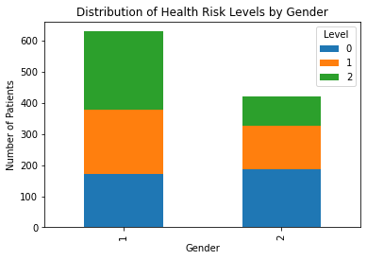
Health Risk Levels by Gender
Level 0 - Low Health risk
Level 1 - Medium Health risk
Level 2 - High Health risk
1 - Male
2 - Female
7

Slide 9
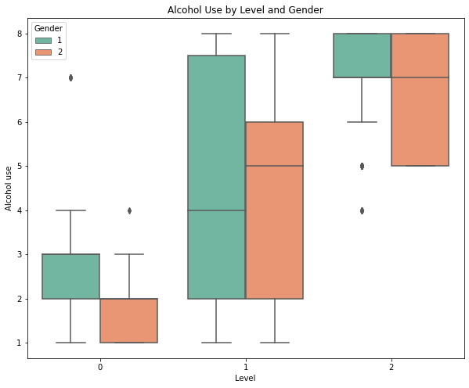
Alcohol Use By Gender
Non-drinker: More females appear to be non-drinkers than males.
Low: The distribution of low consumers seems similar between genders, possibly with slightly more males.
Medium: The box for males extends further to the right in the medium level, suggesting more males are medium-level drinkers than females.
High: Similar to medium, the box for males in the high level extends further to the right, indicating more high-level drinkers among males.
8

Slide 10
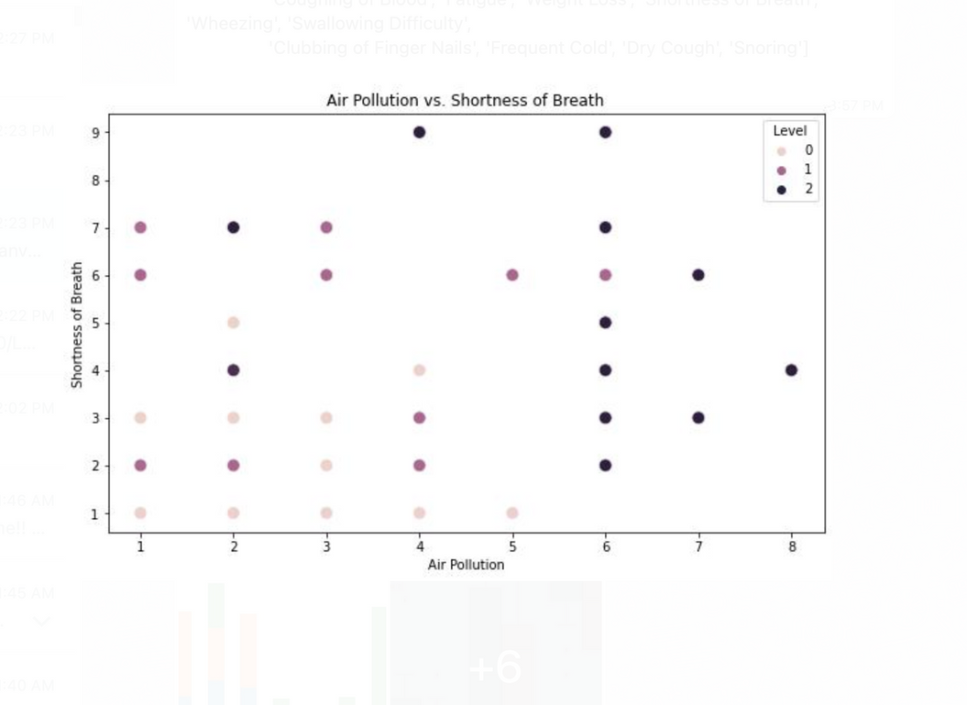
Shortness of Breath By Air Pollution
Shortness of breath is reported more frequently at higher levels of air pollution.
There are more data points in the upper right corner of the graph, where the air pollution is high and shortness of breath is common.
9

Slide 11
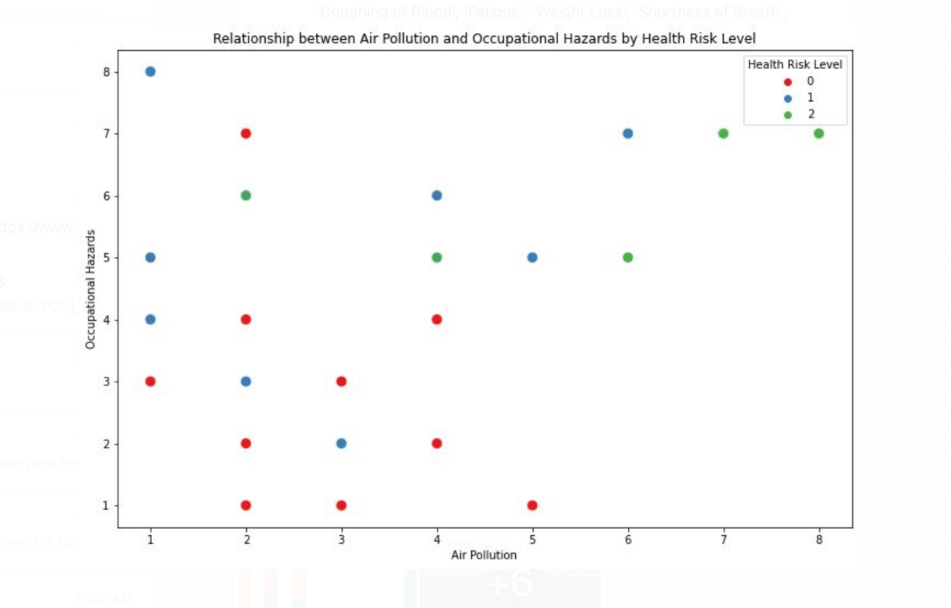
Air pollution and Occupational Hazards
Low Health Risk is observed for low ranges of Air Pollution and Occupation Hazards.
Medium Risk level is seen in patients who were more prone to occupational hazards and were also exposed to air pollution levels.
High Health Risk level is seen in patients who were extremely exposed to the air pollution
x-axis : Air Pollution
y axis Occupational Hazards
Level 0 - Low Health risk
Level 1 - Medium Health risk
Level 2 - High Health risk
10

Slide 12
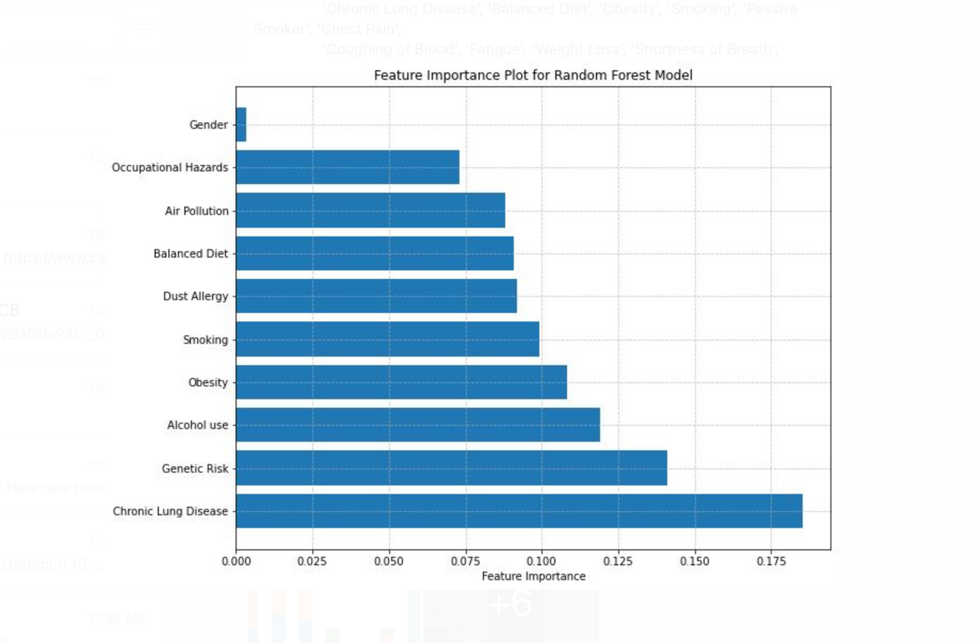
Feature Importance Plot
Shows Feature Importance: It reveals which features were most influential in a model's predictions.
Higher Bars, Higher Importance: Features with taller bars contributed more to the model's decisions.
11

Slide 13
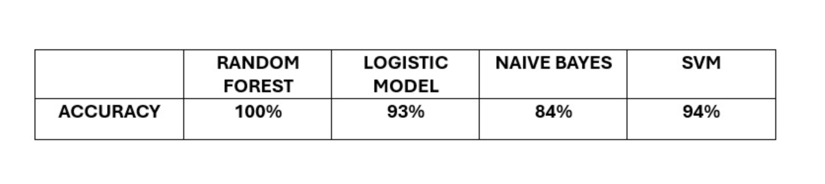
Models
12

Slide 14
Problem Statement 2
Chronic Lung Disease
Identifying primary factors contributing to respiratory health issues such as chronic lung disease, coughing of blood, and shortness of breath among patients.
Understanding how these factors intersect to inform effective prevention and management strategies.
13

Slide 15
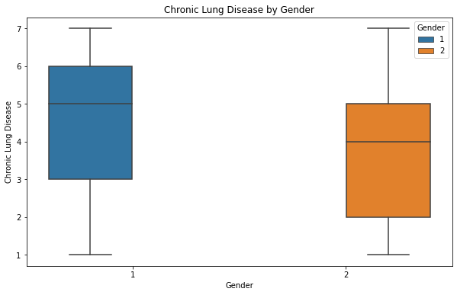
Chronic lung disease by Gender
Similar Distribution: Boxes are height is similar, suggesting chronic lung disease is spread similarly between Male and Female.
Possible Gender Difference: There may be a slightly higher frequency in Male compare to Female.
14

Slide 16
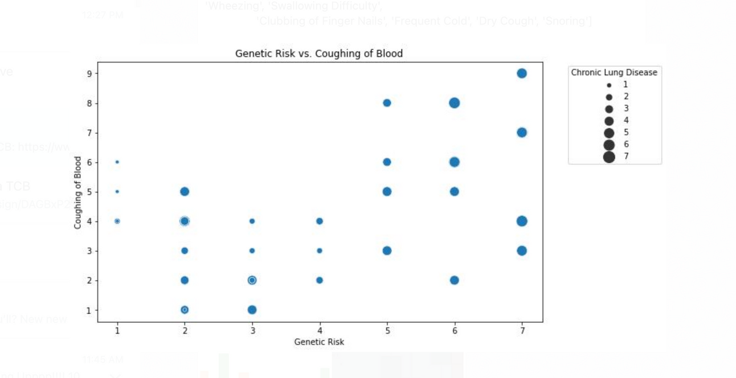
Coughing of Blood By Genetic Risk
Genetic Risk: The graph indicates a correlation between certain genes and increased risk of coughing up blood, a symptom of some respiratory diseases.
Genetic factors can influence the immune system's response to allergens or infections.
As we age, lung function naturally declines. This decline, combined with a genetic predisposition, could significantly increase the risk of coughing blood from respiratory illnesses.
15

Slide 17
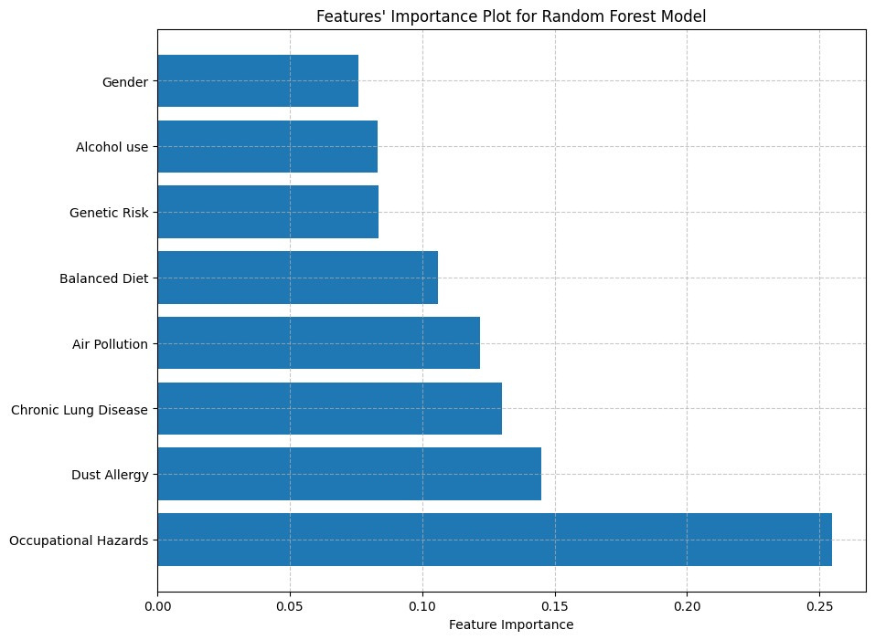
Feature Importance Plot
16

Slide 18
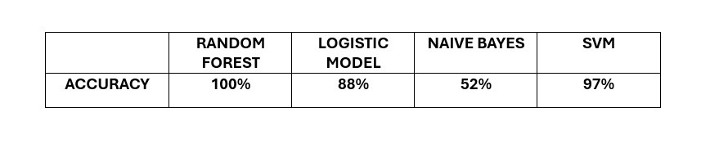
Models
17

Slide 19
Conclusion
Gender disparity in drinking habits: Females show higher rates of abstaining.
Gender influence on alcohol consumption levels: Males dominate medium to high consumption.
Environmental factors and health risks: Air pollution correlates with higher health risks.
Gender and chronic lung disease: Similar distribution implies equal prevalence between genders.
Potential male predominance: Slight male frequency suggests a gender difference.
Genetic influence on respiratory health: Certain genes correlate with increased risk of coughing up blood.
18

Slide 20
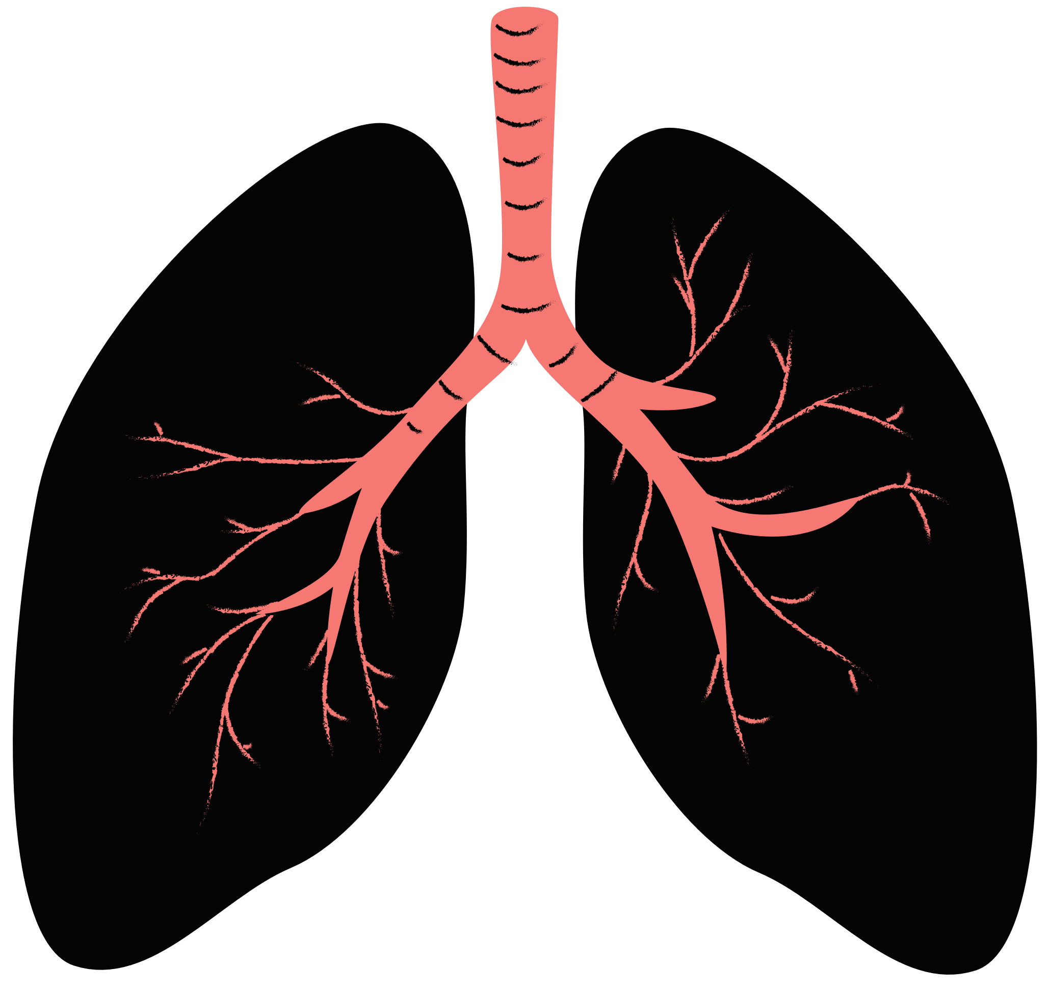

THANK YOU

